Slide 1
Sequential digital circuit

Slide 2
Lecture 35 Flip flops and latches
Lecture delivered by:
Deepak V.

Slide 3
Objectives
At the end of this lecture, student will be able to:
Define flip flop and latches
Design flip flops using basic gates and SR flip flop
Acquire knowledge about various flip flops and latches
Differentiate between flip flops and latches

Slide 4
Topics
Flip flops
Latches
Realization of flip flops using SR flip flop
Realization of flip flops using basic gates

Slide 5
Storage Elements
Storage element in a digital circuit can maintain a binary state indefinitely until directed by an input signal to switch states
Storage elements that operate with signal levels (rather than signal transitions) are referred to as latches
Storage elements that are controlled by a clock transition are flip-flops
Latches are useful for storing binary information and for the design of asynchronous sequential circuits

Slide 6
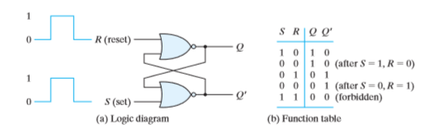
SR Latch
The SR latch is a circuit with two cross-coupled NOR gates or two cross-coupled NAND gates, and two inputs labeled S for set and R for reset
The SR latch constructed with two cross-coupled NOR gates is shown
SR latch with NOR gates

Slide 7
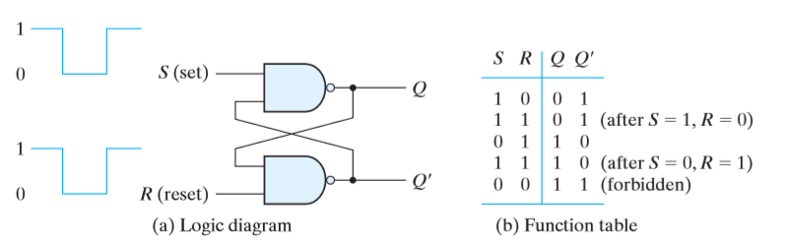
SR Latch
SR latch with NAND gates

Slide 8
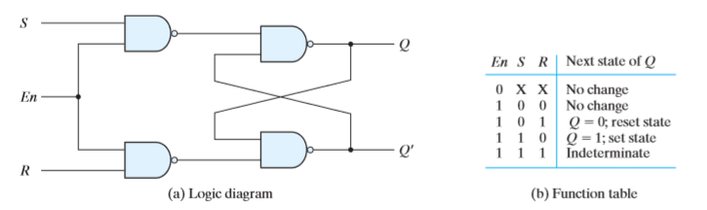
SR Latch
The operation of the basic SR latch can be modified by providing an additional input signal that determines (controls) when the state of the latch can be changed
This is done by determining whether S and R can affect the circuit
SR Latch with enable

Slide 9
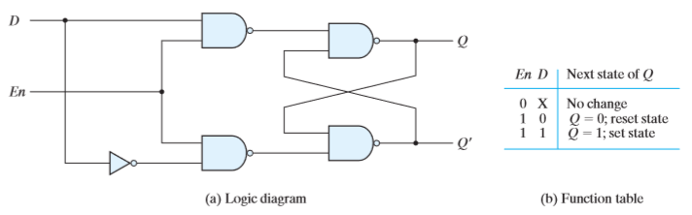
D Latch
One way to eliminate the undesirable condition of the indeterminate state in the SR latch is to ensure that inputs S and R are never equal to 1 at the same time
S and R are never equal to 1 at the same time. This is done in the D latch, shown in Figure below
D latch

Slide 10
Flip Flops
Controlled latches are level-triggered
Flip-Flops are edge-triggered
C
CLK
Positive Edge
CLK
Negative Edge

Slide 11
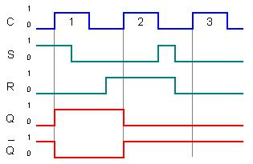
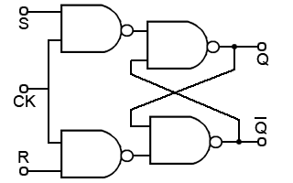
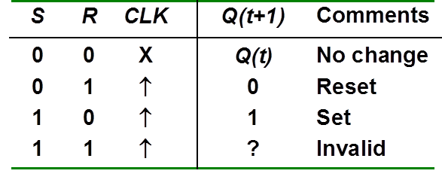
SR Flip Flops
SR flip flop timing diagram
SR flip flop
SR flip flop truth table

Slide 12
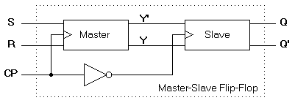
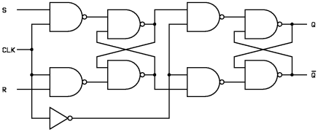
Master slave SR Flip Flops
Master
Slave

Slide 13
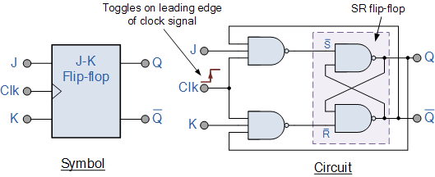
JK Flip Flops
SR NAND flip flop suffers from two basic problems
The S = 0 and R = 0 condition (S = R = 0) must always be avoided
If S or R change state while the enable input is high the correct
latching action may not occur
The JK flip flop is basically a gated SR Flip-flop
JK flip flop using NAND GATE
Sequential Logic: Analysis and Synthesis

Slide 14
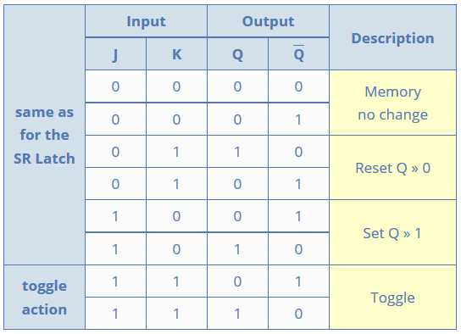
JK Flip Flops
JK flip flop truth table

Slide 15
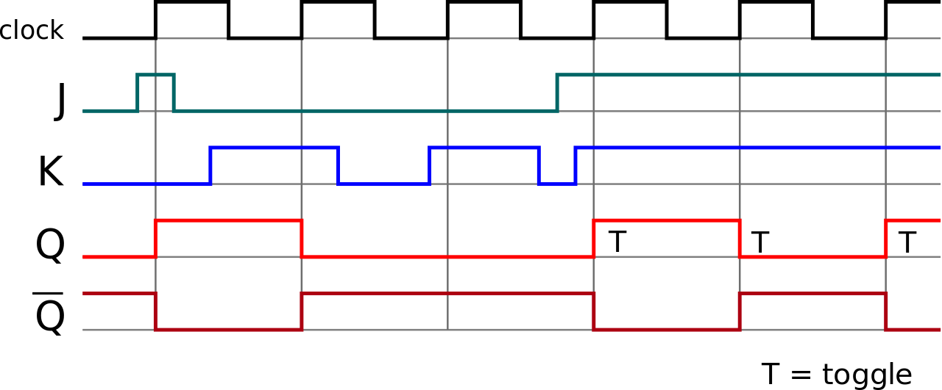
JK Flip Flops
JK flip flop Timing diagram

Slide 16
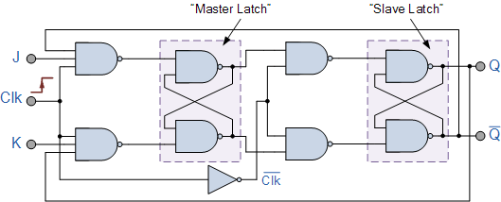
Master Slave JK Flip Flops
The Master-Slave Flip-Flop is basically two gated SR flip-flops connected together in a series configuration with the slave having an inverted clock pulse
The outputs from Q and Q from the “Slave” flip-flop are fed back to the inputs of the “Master”
outputs of the “Master” flip flop being connected to the two inputs of the “Slave” flip flop
JK flip flop truth table

Slide 17
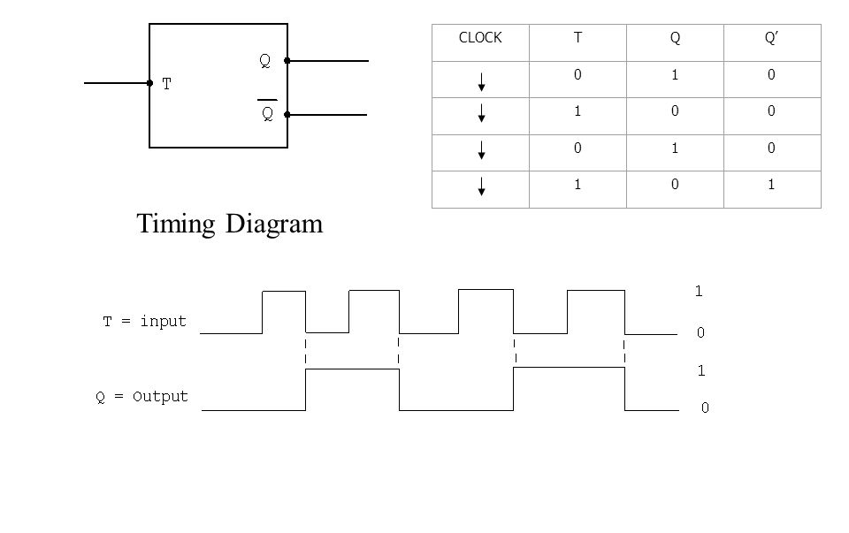
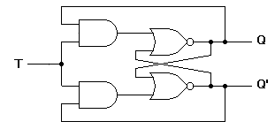
T Flip Flop
T flip flop
T flip flop truth table

Slide 18
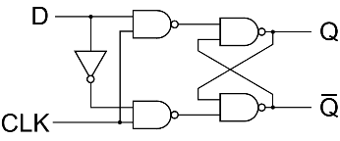
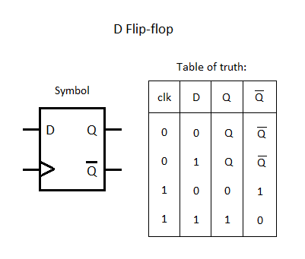
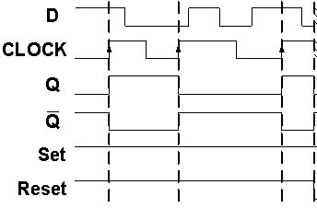
D Flip Flop
D flip flop
D flip flop truth table
D flip flop timing diagram

Slide 19
Summary
Storage element in a digital circuit can maintain a binary state indefinitely until directed by an input signal to switch states
A Sequential circuit is specified by a time sequence of inputs, outputs, and internal states
A Mealy Machine is an FSM whose output depends on the present state as well as the present input
Moore machine is an FSM whose outputs depend on only the present state

